Slide 1
DriverPass System Analysis
Joshua Wozny
joshua.wozny@snhu.edu
Notes:
[No speaker notes required for this slide.]

Slide 2
Overview
DriverPass hopes to bring to market a system to train students for the driving test at their local department of motor vehicles (DMV). It should be able to provide online classes and practice tests to enrolled students. It should also facilitate the scheduling of on-the-road driving instruction.
Notes:
[No speaker notes required for this slide.]

Slide 3
Understanding the problem
Item 1
Item 2
Item 3
Provide tools to students to enroll and take online classes and practice tests
Provide tools to students and staff to schedule on-the-road instruction
Provide administrative tools and reports to DriverPass management
Notes:
The system is meant to fill a void in the market, providing online - and in-person - instruction to students preparing for their driver's test with the DMV with the following components

Slide 4
Project objectives:
Administrative data can be accessed by DriverPass employees from any computer or mobile device.
Different employees at the company will have different privileges and roles.
Tracks who makes/changes/cancels a reservation or enrollment.
Provide administrative activity reports.
Enrollment can be accomplished online by students or by DriverPass employees over the phone.
Enrolled students can access online classes and available practice tests from any computer or mobile device.
The online test progress should show the tests taken and overall progress. It should indicate name, time taken, score, and status (not taken, in progress, failed, or passed).
Support for several different on-the-road training packages with a different number of training hours and support options.
On-the-road driving instruction can be reserved by the student online or by DriverPass employees over the phone. Reservations can be created, modified, or canceled.
Internally, the system must be able to assign road instructions to available drivers.
Driver needs to be able to log each lesson, its start and end time, and make comments.
Notes:
[No speaker notes required for this slide.]

Slide 5
NON-FUNCTIONAL
The system should be a web-based system that has the following parameters:
Maximum uptime. The Services should be available as close to 24 hours a day, 365 days a year
Web pages should be responsive, i.e., look good on all types of devices with differing screen sizes and processor speeds
The system should run on any web-browser enable device with internet access, with support for the following Operating Systems, at a minimum:
Windows
Mac OS
Linux
System Requirements
FUNCTIONAL
The system shall validate user credentials when logging on to the system
The system shall direct the user to the correct landing page based on their role - Student, Admin, or Driver
The system shall log interactions between users and the system and report to the Super admin user and IT administrators (also Super admins)
The system shall allow students to self register
The system shall allow for online payment of fees
Notes:
To support Driver’s Pass’ vision of providing driver’s education services online, and in person, we performed an analysis of your needs resulting in a number of functional and non-functional requirements. Functional requires describe how the system must work, and non-functional requirements describe how the system must perform.

Slide 6
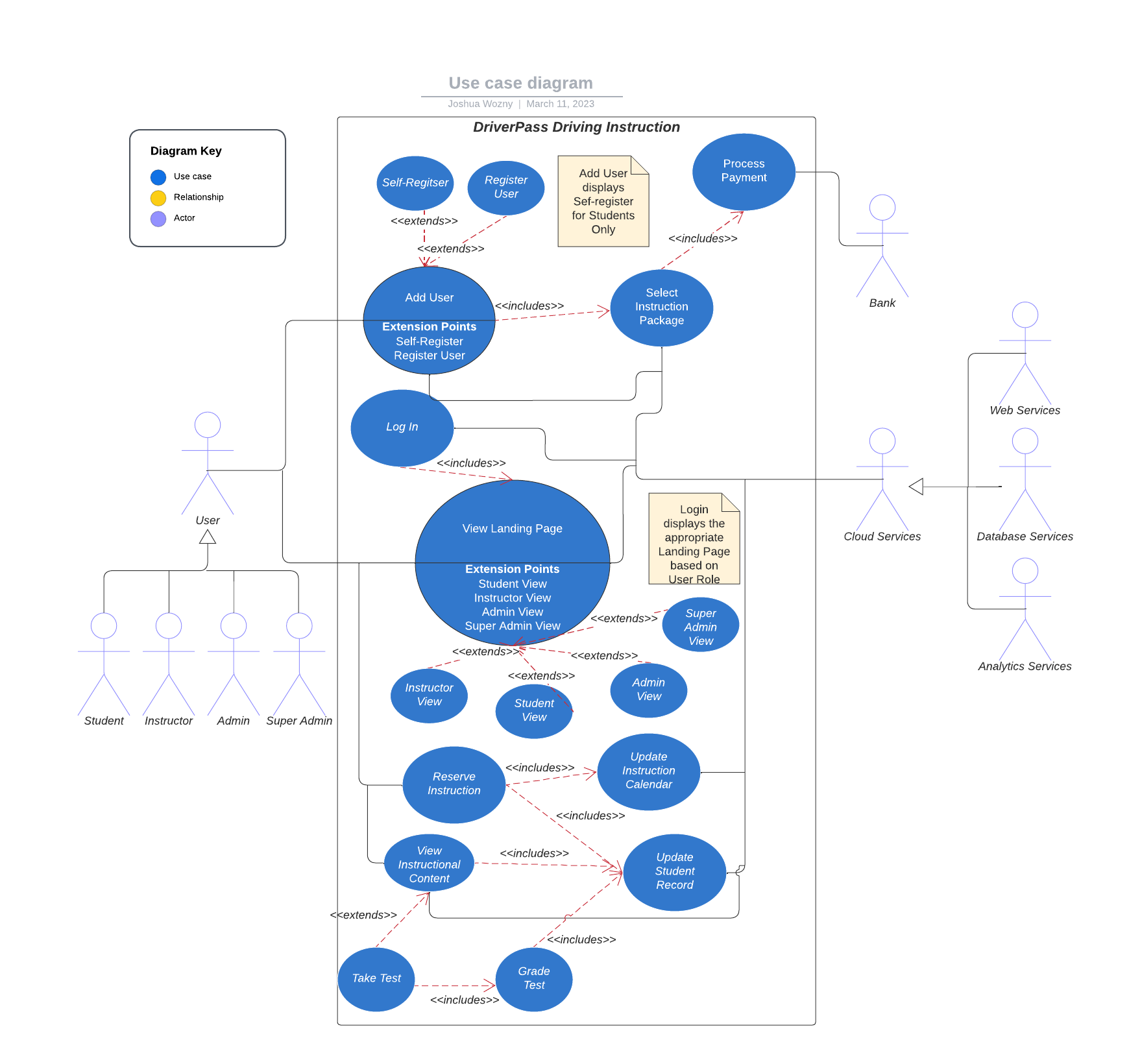
Use Case Diagram
Notes:
From our requirements we developed use cases for each of the functions that an Actor wants to perform in the system. The use case diagram shows the relationships between use cases and how Actors interact with each use case.

Slide 7
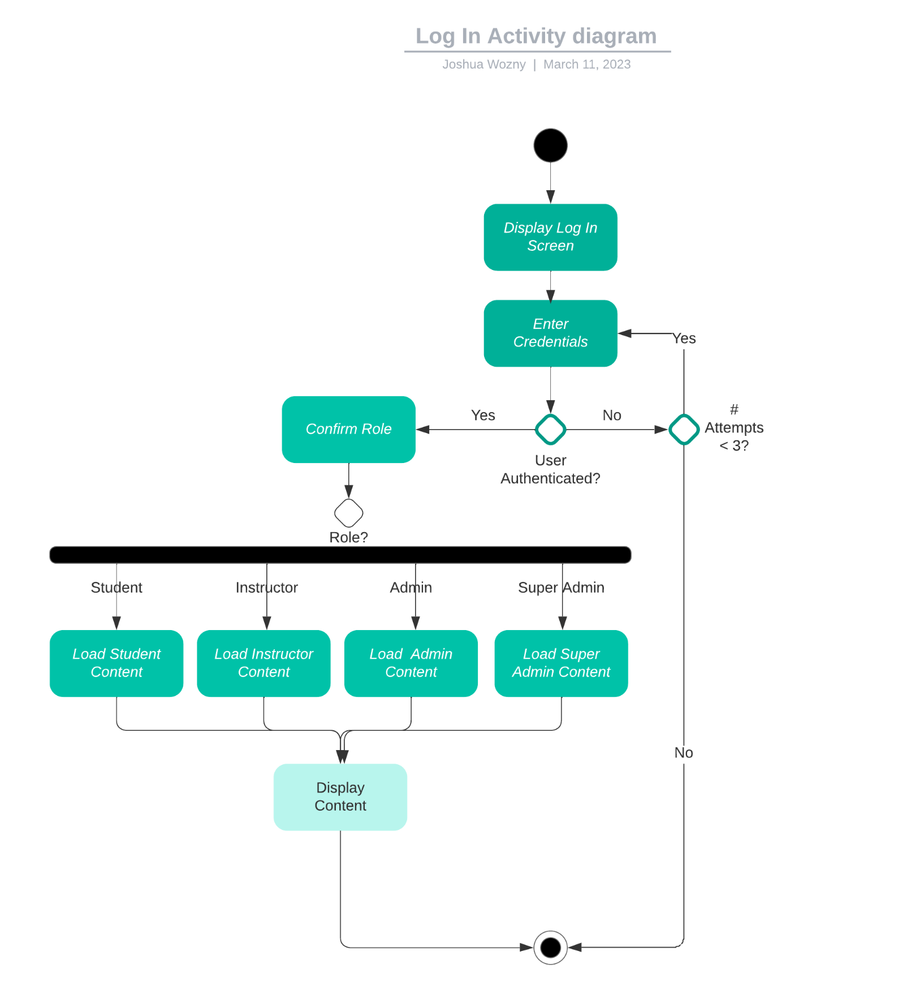
Activity Diagram
Notes:
The activity diagram is constructed to show the steps needed to accomplish a particular use case. In this diagram the Login use case is modeled. Let me walk you through the diagram.

Slide 8
Security
Multi-factor Authentication will be required to access the system. A user must create a strong password and provide an e-mail address or cell phone number for authentication purposes.
After multiple failed attempts, the account will be disabled and further action by the user and/or administrators to restore
A user may reset the password by using a security question answer provided during account setup
Users should be alerted if there is a strong suspicion that their account has been compromised
Notes:
Security of the DriverPass system is a vital component. User’s data must be protected, we address this with these concerns in multiple ways

Slide 9
Assumptions
Users have internet access
The system will reside in an offsite cloud-based system to maximize uptime, providing robust security and scalable performance
Limitations
System will be unavailable if the cloud service experiences downtime
Users will not be able to access the system if their internet connection goes down.
Must abide by Cloud Service Provider Terms of Service. This should not seriously limit the system but should be periodically reviewed to ensure the system is in compliance
Notes:
As we designed the system, we made certain assumptions. We also identified a number of limitations that you should be aware of and we can discuss any concerns you may have.

Slide 10
Technical Requirements
Cloud Services
Web Server
Analytics Service
Database Server with PostgreSQL
Virtual Machine running Linux to run the back-end application
All Web browsers on Supported Platforms
Windows
Macintosh
Linux
Android
iOS
Notes:
Our current plan has the system running on a Cloud-based system. There are a few different options including Google Cloud, Azure, and AWS.

Slide 11
Question & Answer

